Slide 1
Files and File systems in Linux

Slide 2
Device Files
A device special file corresponds to a device on the system. Within the kernel,
each device type has a corresponding device driver, which handles all I/O requests
for the device. A device driver is a unit of kernel code that implements a set of oper-
ations that (normally) correspond to input and output actions on an associated
piece of hardware. The API provided by device drivers is fixed, and includes opera-
tions corresponding to the system calls open(), close(), read(), write(), mmap(), and ioctl().
The fact that each device driver provides a consistent interface, hiding the differ-
ences in operation of individual devices, allows for universality of I/O.
Some devices are real, such as mice, disks, and tape drives. Others are virtual,
meaning that there is no corresponding hardware; rather, the kernel provides (via
a device driver) an abstract device with an API that is the same as a real device.
Devices can be divided into two types:
Character devices handle data on a character-by-character basis. Terminals and
keyboards are examples of character devices.
Block devices handle data a block at a time. The size of a block depends on the
type of device, but is typically some multiple of 512 bytes. Examples of block
devices include disks and tape drives.

Slide 3
Assignment
ls /dev/video0
sudo apt install v4l-utils
v4l2-ctl --list-devices
sudo apt install ffmpeg
ffplay /dev/video0
ffmpeg -f v4l2 -i /dev/video0 -frames:v 1 snapshot.jpg

Slide 4
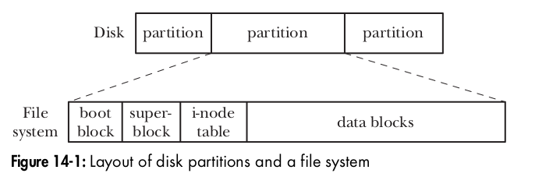
File systems
A file system is an organized collection of regular files and directories. A file system
is created using the mkfs command.
One of the strengths of Linux is that it supports a wide variety of file systems,
including the following:
1. various native UNIX file systems such as the Minix, System V, and BSD file
systems;
2. Microsoft’s FAT, FAT32, and NTFS file systems;
3. the ISO 9660 CD-ROM file system;
4. Apple Macintosh’s HFS;
5. The traditional ext2 file system;
6. a range of network file systems, including Sun’s widely used NFS
7. a range of journaling file systems, including ext3, ext4, Reiserfs, JFS, XFS, and Btrfs.
File system Structure:
The basic unit for allocating space in a file system is a logical block, which is some
multiple of contiguous physical blocks on the disk device on which the file system
resides. For example, the logical block size on ext2 is 1024, 2048, or 4096 bytes

Slide 5
Assignment
losetup --find --show --partscan 2025-05-13-raspios-bookworm-arm64-lite.img
/dev/loop34
lsblk -f
mount /dev/loop34p2 /mnt
losetup -d /dev/loop34

Slide 6
A file system contains the following parts:
Boot block: This is always the first block in a file system. The boot block is not
used by the file system; rather, it contains information used to boot the operat-
ing system. Although only one boot block is needed by the operating system,
all file systems have a boot block (most of which are unused).
Superblock: This is a single block, immediately following the boot block, which
contains parameter information about the file system, including:
- the size of the i-node table;
- the size of logical blocks in this file system; and
- the size of the file system in logical blocks.
Different file systems residing on the same physical device can be of different
types and sizes, and have different parameter settings (e.g., block size). This is
one of the reasons for splitting a disk into multiple partitions.
I-node table: Each file or directory in the file system has a unique entry in the i-node table. This entry records various information about the file. I-nodes are dis-
cussed in greater detail in the next section. The i-node table is sometimes also
called the i-list.
Data blocks: The great majority of space in a file system is used for the blocks of
data that form the files and directories residing in the file system.

Slide 7
I-nodes
A file system’s i-node table contains one i-node (short for index node) for each file residing in the file system. I-nodes are identified numerically by their sequential location in the i-node table. The i-node number (or simply i-number) of a file is the first field displayed by the ls –li command. The information maintained in an i-node includes the following:
- File type (e.g., regular file, directory, symbolic link, character device).
- Owner (also referred to as the user ID or UID) for the file.
- Group (also referred to as the group ID or GID) for the file.
Access permissions for three categories of user: owner (sometimes referred to as user), group, and other
- Three timestamps: time of last access to the file (shown by ls –lu), time of last modification of the file (the default time shown by ls –l), and time of last status change (last change to i-node information, shown by ls –lc). As on other UNIX implementations, it is notable that most Linux file systems don’t record the creation time of a file.
- Number of hard links to the file.
- Size of the file in bytes.
- Number of blocks actually allocated to the file, measured in units of 512-byteblocks.
- Pointers to the data blocks of the file.
root@rama-Inspiron-3501:/home/rama# df -i /dev/nvme0n1p2
Filesystem Inodes IUsed IFree IUse% Mounted on
/dev/nvme0n1p2 15597568 7953145 7644423 51% /

Slide 8
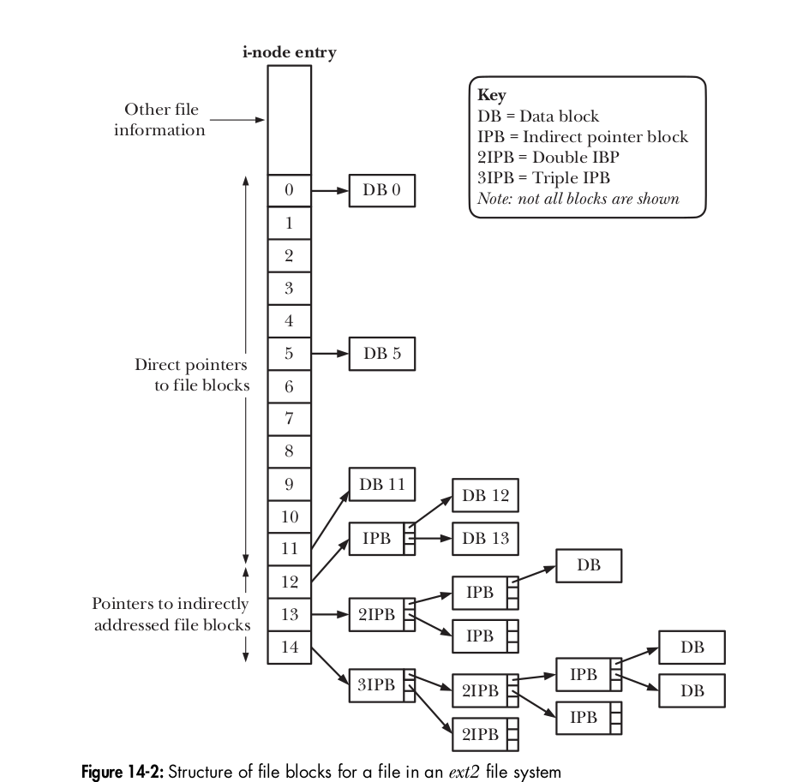
File block structure

Slide 9
Assignment (Risky)
df -i
mkdir /tmp/inode-test
cd /tmp/inode-test
for i in $(seq 1 1000000); do
touch file_$i
done

Slide 10
Journaling File Systems
The ext2 file system is a good example of a traditional UNIX file system, and suffers
from a classic limitation of such file systems: after a system crash, a file-system con-
sistency check ( fsck) must be performed on reboot in order to ensure the integrity
of the file system. This is necessary because, at the time of the system crash, a file
update may have been only partially completed, and the file-system metadata
(directory entries, i-node information, and file data block pointers) may be in an
inconsistent state, so that the file system might be further damaged if these incon-
sistencies are not repaired. A file-system consistency check ensures the consistency
of the file-system metadata. Where possible, repairs are performed; otherwise,
information that is not retrievable (possibly including file data) is discarded.
The problem is that a consistency check requires examining the entire file sys-
tem. On a small file system, this may take anything from several seconds to a few
minutes. On a large file system, this may require several hours, which is a serious
problem for systems that must maintain high availability (e.g., network servers).
Journaling file systems eliminate the need for lengthy file-system consis-
tency checks after a system crash. A journaling file system logs (journals) all
metadata updates to a special on-disk journal file before they are actually carried
out. The updates are logged in groups of related metadata updates (transactions). In
the event of a system crash in the middle of a transaction, on system reboot, the log
can be used to rapidly redo any incomplete updates and bring the file system back
to a consistent state. (To borrow database parlance, we can say that a journaling
file system ensures that file metadata transactions are always committed as a com-
plete unit.) Even very large journaling file systems can typically be available within
seconds after a system crash, making them very attractive for systems with high-
availability requirements

Slide 11
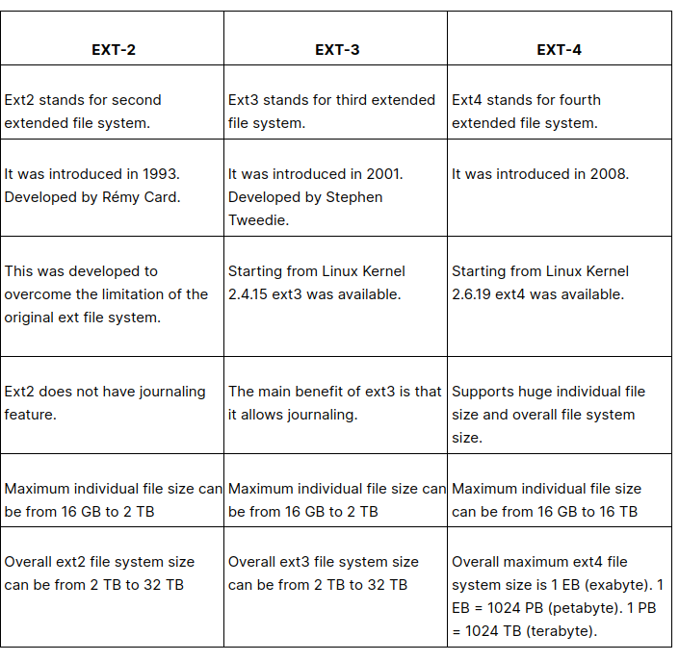
Ext4
Ext4 stands for fourth extended file system.
It was introduced in 2008.
Starting from Linux Kernel 2.6.19 ext4 was available.
Supports huge individual file size and overall file system size.
Maximum individual file size can be from 16 GB to 16 TB
Overall maximum ext4 file system size is 1 EB (exabyte).
1 EB = 1024 PB (petabyte). 1 PB = 1024 TB (terabyte).
Directory can contain a maximum of 64,000 subdirectories
(as opposed to 32,000 in ext3)
You can also mount an existing ext3 fs as ext4 fs (without having to upgrade it).
Several other new features are introduced in ext4: multiblock allocation,
delayed allocation, journal checksum. fast fsck, etc. .
In ext4, you also have the option of turning the journaling feature off.

Slide 12
Assignment
https://www.cyberciti.biz/faq/howto-create-linux-ram-disk-filesystem/
https://www.cyberciti.biz/faq/howto-create-linux-ram-disk-filesystem/
https://www.cyberciti.biz/faq/howto-create-linux-ram-disk-filesystem/
Verify Journal file system support with sudo tune2fs -l /dev/sda1 | grep -i journal
dd if=/dev/zero of=/tmp/testfs.img bs=1M count=100
sudo mkfs.ext4 /tmp/testfs.img
sudo mkdir /mnt/testfs
sudo mount /tmp/testfs.img /mnt/testfs
sudo tune2fs -l /tmp/testfs.img | grep has_journal
cd /mnt/testfs
sudo touch file1
sudo mkdir demo
echo "Journaling test" | sudo tee demo/test.txt
sudo umount -l /mnt/testfs # lazy unmount (simulate crash)
sudo tune2fs -l /tmp/testfs.img | grep needs_recovery
sudo e2fsck -f /tmp/testfs.img

Slide 13
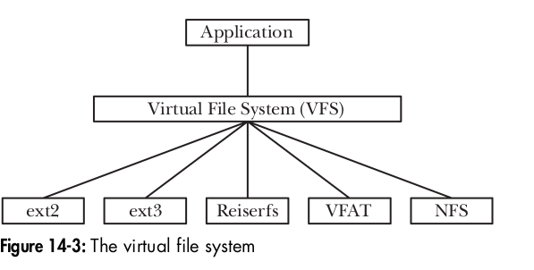
Virtual File Systems
The Virtual File System (VFS)
Each of the file systems available on Linux differs in the details of its implementation. Such differences include, for example, the way in which the blocks of a file are allocated and the manner in which directories are organized. If every program that worked with files needed to understand the specific details of each file system, the task of writing programs that worked with all of the different file systems would benearly impossible. The virtual file system (VFS, sometimes also referred to as the virtual file switch) is a kernel feature that resolves this problem by creating an abstraction layer for file-system operations
The ideas behind the VFS are straightforward:
The VFS defines a generic interface for file-system operations. All programs that work with files specify their operations in terms of this generic interface. Each file system provides an implementation for the VFS interface. Under this scheme, programs need to understand only the VFS interface and can ignore details of individual file-system implementations.
The VFS interface includes operations corresponding to all of the usual system calls for working with file systems and directories, such as open(), read(), write(), lseek(), close(), truncate(), stat(), mount(), umount(), mmap(), mkdir(), link(), unlink(), symlink(), and rename().
cat /proc/filesystems
/proc
/sys

Slide 14
